Slide 1
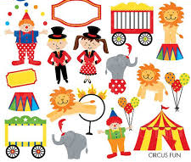
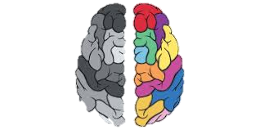
Brilliant Beginning
This is Me Box – Children to create and bring in to share with class
This is Me!
Kindness
Respect
Cooperation
We will learn about the Phoenix Values through assemblies and circle time and value stories
F2’s Greatest Showman – circus skills day
British
Values
Wow
Mindfulness and Growth Mindset
We will teach the children about Take 5 and pausing to be calm and ready. Yoga and breathing techniques will be explicitly taught and embedded into everyday practice
Democracy Rule of law Individual liberty Respect
We will promote the British
Values by learning that we are
unique and we respect others enjoy
different things. We will begin to get to know each other and families through our stay and play sessions and using Tapestry.
F2 23/24
Autumn Term

Slide 2
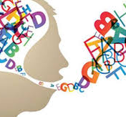
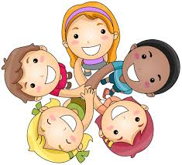
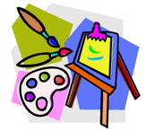
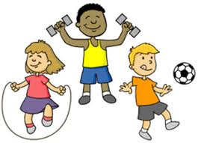
Communication and Language
Personal, Social and Emotional
We want the children to learn to talk about themselves and others. To sing songs. To speak about a range of texts. To know about others. To know familiar songs. To describe different story and non-fiction texts.
We have story time daily and choose appropriate stories. Children
will start to hear simple instructions when learning routine. Children have opportunity to share ‘This is Me’ box and hear about their class mates.
We want the children to learn to describe a friend. To know and demonstrate friendly behaviour. To understand how to be a good friend. To learn to join in with whole group activities. To choose an activity independently. To describe and show friendly behaviour. To begin taking turns with their friends
We will continue to work on building relationships with the children and support with settling into school and the transition. We will play with the children, modelling play and supporting.
This is Me!
Expressive Arts and Design
Understanding the World
We want the children to learn to remember the words to a range of songs. To give meaning to the marks that are made. To learn a range of songs from around the world. To know that people from different countries may have different traditions. For children to be able to safely construct with a purpose and evaluate their designs.
We will support children in creative area to look at colours and
in the construction areas to use resources. Children can access
role play and home corner areas both inside and out. Children
will have opportunities to talk about designs as well as reflect
and share what they have done/thinking.
We want the children to learn to talk about how they have changed since they were a baby. To talk about the changes they observe in their environment – Seasons link. To know the names of different body parts. To know that there are many countries around the world. To know that people in other countries may speak different languages.
We will use the all about me pages and This is Me boxes to
talk about changes in themselves. We will learn and talk about
differences and children’s and families race and traditions and
celebrations, how to respect them. Focus countries will be chosen to represent the children at Phoenix.
Physical Development
We want the children to learn to use a dominant hand. To begin to form recognisable letters which are formed mostly correctly. To use climbing equipment safely and competently. To begin to negotiate space effectively. To know which hand to write with. To know how to use the trim trail safely. To know how to use scissors effectively.
We will have a range of equipment outside for children to use to support movement and balance. We will work on using the finger gym and disco dough to build muscles to support pencil control and grip

